Slide 1
Homoepathic Medicines Prepared from Spiders
Prepared by
Dr.SREEJA.S, H.o.D,
Department of Homoeopathic Pharmacy

Slide 2
Spiders form the largest and most widely distributed order of class of animals called ARACHNIDA, which also includes the scorpions, mites and ticks.
There are about 22,000 different species of spiders of which about 500 are British. The largest are found in Central America and have a body length of about 3.5 inches, the smallest species are less than one fourth of an inch long.

Slide 3
Class Arachnida consist of two types of spiders
1. ARANOMORPHAE with one pair of lungs.
2. MYGALOMORPHAE with two pairs of lungs.
More species belong to the Aranomorphae and they are called the true spiders or tarentulas
Bodies of animals belonging to class Arachnida – consist of 2 parts
(a) The front – head and chest closely joined forming cephalothorax;
(b) The behind – the abdomen.

Slide 4
GREEK MYTHOLOGY
In ancient Greece there lived a woman called Arachne who was famous for her skill in weaving. Her skill at her art made her very conceited, thinking that there was none better than her.
In her conceit she challenged the Goddess Athene to a weaving contest. Arachne’s effort was very beautiful and it aroused jealousy in Athene was felt threatened by Arachne.
Athene was the goddess of all weaving..

Slide 5
In her fit of rage she tore Arachne’s weaving to pieces. Arachne was very upset and she hung herself, where upon Athene changed her into a spider and condemned her to go on weaving forever. Hence, the name Arachnida which really means “Children of Arachne.”
The have a pair of jaws, a pair of pincer claws and 4 pairs of legs, all attached to the cephalothorax

Slide 6
MEDICINES
Aranea Diadema
Aranea Ixolobo
Aranea Scinencia
Aranerum Tela (cobweb).
Latrodactus Hasselti
Latrodactus Katipo
Latrodactus Mactans
Mygale Lasiodora
Tarentula cubensis
Tarentula Hispania
Theridion curassavicum.

Slide 7
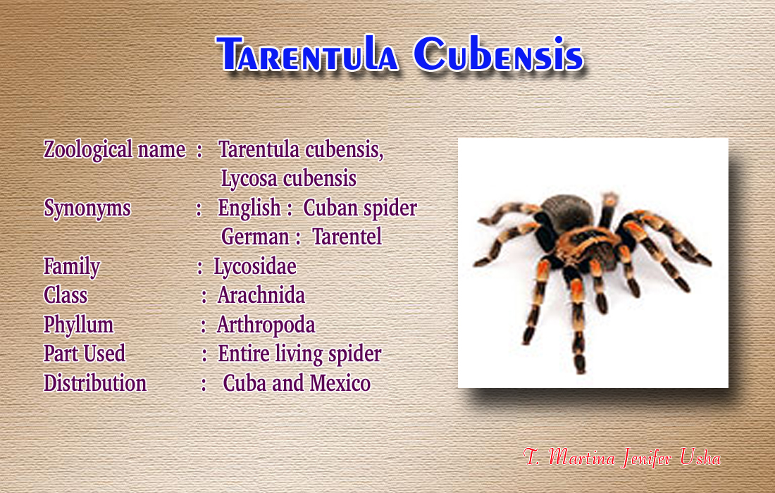

Slide 8
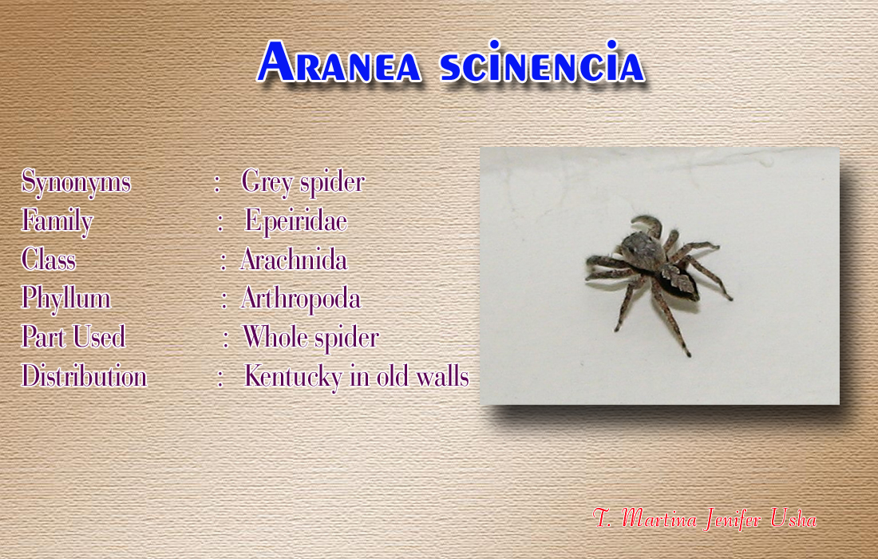

Slide 9
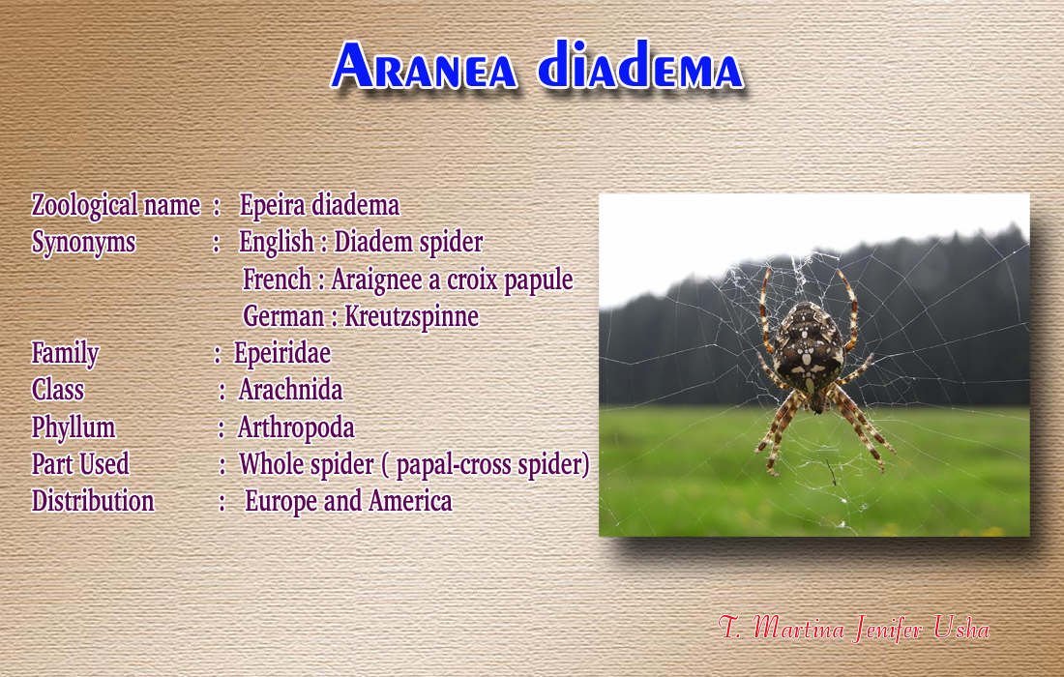

Slide 10
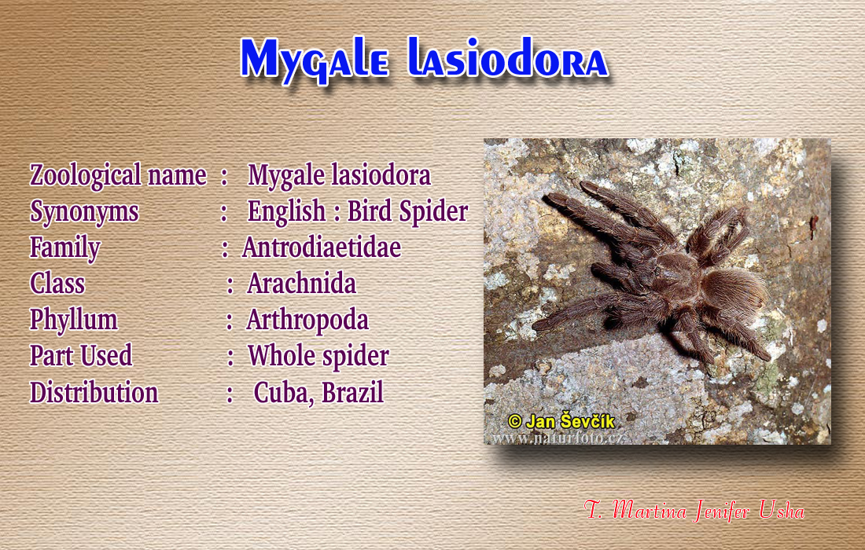

Slide 11
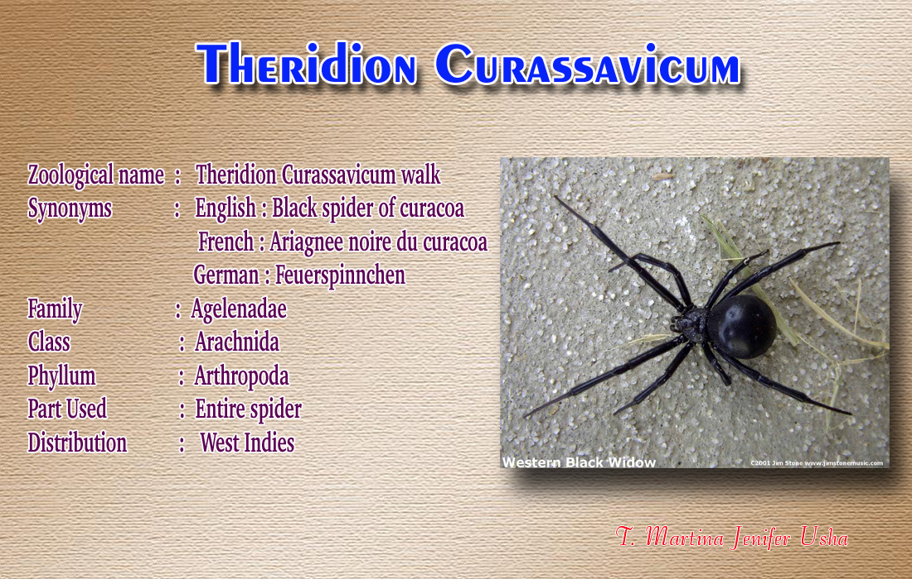

Slide 12
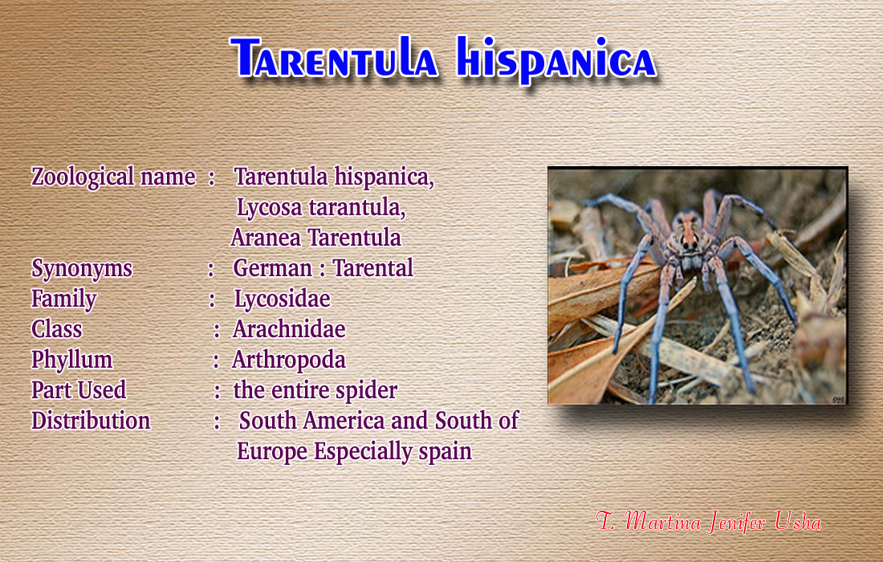

Slide 13
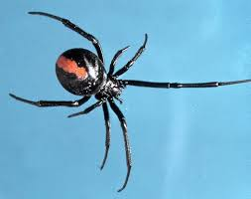
Latrodectus hasselti phyllum – Arthropoda Class Insecta CN – New South Wales Spider

Slide 14
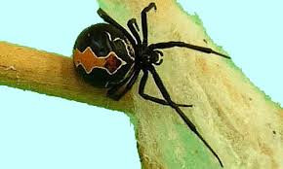
Lactrodectus katipo
New Zealand Spider

Slide 15
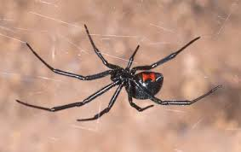
Latrodectus mactans
Black Widow Spider

Slide 16
DOCTRINE OF SIGNATURE
Spiders are restless - Patients are always restless both mentally and physically
Spider captures the prey cunningly by spinning the web – Patient is also cunning and deceptive in character
Action of spider poison is violent - Patient develop symptoms violently
Male spider will dance during mating - Patient desires to dance which relieves the complaints

Slide 17
SPIDER POISONING
Bitten area seen as 2 small red pin prick spots
Bite site suffer from severe pain and cramps
The part becomes swollen and discoloured
Lymphatic glands enlarged
Cellulitis with swelling of a dark red or purplish hue
Choking due to spasm of muscles of deglutition
Epistaxis of dark blood clots
Cerebral congestion with throbbing of carotids

Slide 18
Pale earthy hue to face
The fauces appear swollen and purplish
Difficulty of swallowing
Burning thirst for large quantity of water
Stools are dark and foetid
Urine scanty and voided with difficulty
Increased BP and HR and salivation
Constriction of blood vessels, tingling and numbness

Slide 19
PATHOPHYSIOLOGICAL ACTION
BLOOD – Destruction of RBC, raised E.S.R, increased neutrophill count
CNS – Psychomotor excitation, paralysis of facial muscles, widening of pupils, severe burning and pain, intense pain in extremities and back, excitation of peripheral nerves
SKIN –Roseola , vesicles, papules, pustular rashes with intense itching, necrosis of skin and tissue
GIT – Acute abdominal pain and rigidity of muscles
GUT – Moderate albuminuria and hematuria

Slide 20
CNS ACTION
NEUROTOXIC VENOM acts on
Motor nerves and produces chorea with jerking of muscles
Trembling, Anxiety, Oversensitiveness
Twitching of muscles of face, arm and leg, constant motion of whole body
Jerking of head and extremities
Mouth and eye open and close in succession
Gait unsteady and spine sensitive to touch

Slide 21
DRUG PICTURE
All spiders have marked action or blood giving a picture of blood poisoning and septicemia and produces septic fever
) Marked action on the central nervous system,
Anxiety,
Trembling,
Twitching,
Restlessness,
Oversensitiveness,
Nervous prostration,
Chorea and involuntary movements of single or group of muscles.

Slide 22
RESTLESSNESS - Always changing places cannot remain still, rolling from side to side in bed.
Excessive weakness. Weakness from sexual excesses
“Instability” is the outstanding feature. Instability of action, purpose, wisdom, etc.
Periodicity:- Symptoms recur annually.

Slide 23
Affinity towards skin. Causing deep destruction of tissues.
Carbuncles ,Burning, Actinomycosis
Smoking amelioration
Desires.
Alcoholic drinks,Ashes ,Bananas ,Cold drinks,Seasoned food,Raw food,Tobacco
Aversions.
Bread ,Meat, Chocolate

Slide 24
Sexual
Sexual excitement . Lascivious. But aggravation from coition – leading to sadness, weakness, dyspnoea etc.
Rapidity of onset of symptoms.
Doctrine of Signature:-
A spider attacks suddenly and disappears before the victim can react. This explains the sudden onset of symptoms.

Slide 25
MENTAL SYMPTOMS
Spiders stay in burrows, holes and light and Aversion to society are marked mental symptoms.
Selfish, cunning, whimsical and quarrelsome.
Contrariness, within himself as well as to outer circumstances. Obstructive, interfering.
Great aversion to bright light, objects, colour, etc.

Slide 26
< Contradiction. A/F Contradiction
Music, sensitive to . All complaints react to music not only mental, but physical symptoms also > Music.
Contrariness. Cheerfulness or gaiety alternating with Anger, irritability. Aversion to company but wants someone present nearby.
Hysterical. Causeless weeping, feigning and malingering.
All mental symptoms ameliorated by eating. walking.

